Slide 1
Moral Hazard Lecture 8
Vinish Shrestha

Slide 2
Econ 339 - Roadmap
Focus Midterm 1
Focus Midterm 2
Focus Final
Review of Microeconomics
Socioeconomic
Disparities
Chapter 4
Moral hazard
Chapter 11
Intro (from my slides)
The health policy conundrum
Chapter 15
Demand for Insurance
Chapter 7
Uncertainty
Risk aversion
Production of Health
The Beveridge Model
Chapter 16
Adverse selection
Chapters 8 and 9
Akerlof’s market for lemons
Rothschild-Stiglitz model
The American Model
Chapter 18 and slides provided (ACA)
Demand for health care
Chapter 2
Adverse Selection in Real market
Chapter 10
The Grossman model
Chapter 3
Special Topics (if time allows)
Chapter 20
Slides provided
11/1/17
Towson University – V. Shrestha

Slide 3
Part 1. What is moral hazard?

Slide 4
Moral Hazard
The tendency for insurance against loss to reduce incentives to prevent or to minimize the cost of loss
Get insured and drive like a maniac

Slide 5
Moral Hazard
One way to think of it is that insured people take risks that uninsured people would not take
Can get access to medical care
Moral hazard mis-allocates resources and increases medical expenditures
Downside of having health insurance

Slide 6
The moral hazard pattern
An individual faces some risk of a bad event X, and his actions can increase or decrease its likelihood
He holds an insurance contract that will help pay some or all of the costs of X, if it occurs. Thus his price of X is now lower.
In response to the price distortion, he changes his behavior in a way that increases the chance of X or increases the costs of recovering from X.
The insurance company cannot observe this behavior change – there is an information asymmetry. Otherwise the contract would have been written to discourage the riskier behavior.
The individual’s riskier behavior creates a social loss, because the costly event X occurs more than it would have without insurance.

Slide 7
Ex ante vs. Ex post
Ex ante moral hazard: behavior changes that occur before an insured event happens and make that event more likely.
Not exercising
Consuming artery clogging cheeseburger
skipping the flu vaccine
Ex post moral hazard: behavior changes that occur after an insured event happens and make recovering from that event more expensive.
using expensive drugs instead of generics
knee replacement surgery instead of painkillers
Notes:
7

Slide 8
Part II. A graphical representation of moral hazard

Slide 9
Graphical Representation
Consider an individual who loves cheeseburger
But is a heart patient
With no insurance, having a cheeseburger means (in terms of cost)
Monetary price of a cheeseburger
Increased risk of heart attack
Once with health insurance
Reduces the cost of cheeseburger
Can visit the doctors and take medicines

Slide 10
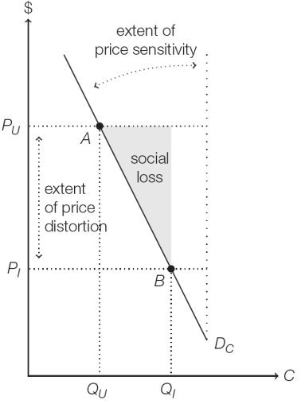
Social loss caused by moral hazard
With insurance, the effective price per cheeseburger falls from P_{U} to P_{I}, and his consumption spikes from Q_{U} to Q_{I}.
Point A is the socially efficient equilibrium, while Point B is the outcome with insurance.
Extra cheeseburgers consumed between points Q_{U} and Q_{I} result in more costs than they are worth.

Slide 11
Social Loss
Social loss happens due to ex ante moral hazard
Takes the form of extra labor, time and effort of other people caring for the person eating too many cheeseburgers (more than that is socially optimal)
The angle between the vertical line and the demand curve shows the price sensitivity
Greater the angle, more price sensitive the person is and larger the social cost
Price elasticity of demand as well

Slide 12
Varying price distortion and price sensitivity
Depends on the elasticity of demand
Depends on price distortion (distance between P_{U} and P_{I})
Even though the demand is elastic, a small price distortion will not have much effect on moral hazard

Slide 13
Varying price distortion and price sensitivity
In Figure A, price distortion and price sensitivity are both quite high. Insured individuals bear little of the cost of their heart attack treatments, and as they are quite price-sensitive they respond with more frequent trips to the local burger joint. This results in a large social loss.

Slide 14
Varying price distortion and price sensitivity
In Figure B, price distortion and price sensitivity are minimal. Insured individuals bear most of the cost of their cheeseburgers, and their demand for burgers is not very sensitive to prices anyway. In this case, there is still moral hazard but it produces a much smaller social loss.

Slide 15
The role of asymmetric information
Asymmetric information occurs between the insurer and the insured party as insurer cannot constantly and accurately monitor an insurer’s behavior (ex ante moral hazard)
Number of cheeseburger a person has in a week
Charge the person accordingly for increasing risk
Case of ex post moral hazard
A person visits the doctor 20 times, hard to identify whether due to illness or person using up free of cost visits

Slide 16
Moral hazard occurs if and only if three conditions hold:
The cost of a risky or wasteful action to an individual is reduced, usually as a consequence of insurance.
Asymmetric information prevents an insurer from adequately pricing the action.
That individual responds to the price distortion by changing his behavior—either by taking more risks or demanding more covered goods and services.

Slide 17
Part III. How to limit moral hazard?

Slide 18
Limiting moral hazard
Cost-sharing: coinsurance and copayment
Deductibles
Monitoring and Gatekeeping

Slide 19
Cost-sharing: coinsurance and copayment
Coinsurance and copayment are two insurance contract provisions that maintain positive marginal costs for the insured. These plans effectively limit insurance coverage so they are no longer full.
Coinsurance: insurance provision in which enrollees pay a percentage of each medical bill, and the insurer covers the remaining portion.
Copayment: insurance provision in which enrollees pay only a fixed amount, called a copay

Slide 20
Cost-sharing: coinsurance and copayment
Without insurance, the individual would consume at point Q_{U}.
Every unit of medical care he consumes would provide at least as much marginal benefit as marginal cost.
But with full insurance, his marginal costs of medical care (from his perspective) fall to zero.
His effective demand curve is D_{F} and he consumes at point Q_{A}

Slide 21
Cost-sharing: coinsurance and copayment
Imagine the consumer starts at 0% coinsurance (full insurance from the previous slide).
His insurer then increases the level of coinsurance.
As coinsurance rises, out-of-pocket prices move closer to actual prices, and the demand curve rotates back toward the uninsured demand curve D_{U}.
At the extreme, coinsurance of 100% is equivalent to no insurance.

Slide 22
Cost-sharing: coinsurance and copayment
Alternatively, imagine his insurer institutes a copay of P_{C} , which becomes the effective price for each episode of care.
This reduces his demand from Q_{A} to Q_{B}.
Note: Such coinsurance and copayments reduce social loss at the expense of increased uncertainty faced by consumers who are no longer fully insured.

Slide 23
Deductibles
In addition to coinsurance and copayment, many insurers also include deductibles as part of their offered plans.
Deductibles set minimal levels of expenses below which the insurer does not help reimburse medical expenses.
Example: A person insured with a deductible of $1,000 pays for his first thousand dollars of health care expenditures out-of-pocket. His insurance policy then helps pay for expenses beyond the thousandth dollar.

Slide 24
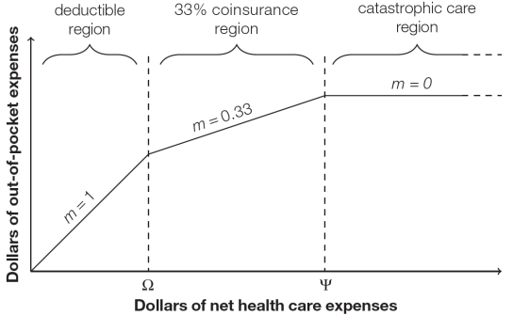
Deductibles
This figure shows the relationship between out-of-pocket expenses and total medical expenditures for a 33% coinsurance policy with a deductible of Ω and full insurance for catastrophic care above Ψ

